Slide 1
Co–Location App Flutter
Made by : A. Dehbi
Assigned by : MR H. Mouncif

Slide 2
AXES :
Application functionalities.
Flutter Packages.
User Interfaces.

Slide 3
1- Application functionalities :
By using this application, the user can:
Register his account.
Sign IN.
Create new Offers.
Create new Requests.
Delete his own offers.
Delete his own Request.
Visualize all offers and their details.
Visualize all Requests and their details.
Visualize all offers on a map using markers.
Visualize all offers details on the map by clicking on the marker.

Slide 4
2- Flutter Packages :
Packages | Usage
Firebase_auth | To Manage the user Authentication and registration by login and password
Cloud_firestore | To Manage data as Json object in realtime
Flutter_map | To integrate maps in flutter apps
Provider | To Provide the wrapped widget by the Stream coming from the firebase.
geocoder | To make forward and reverse geocoding

Slide 5
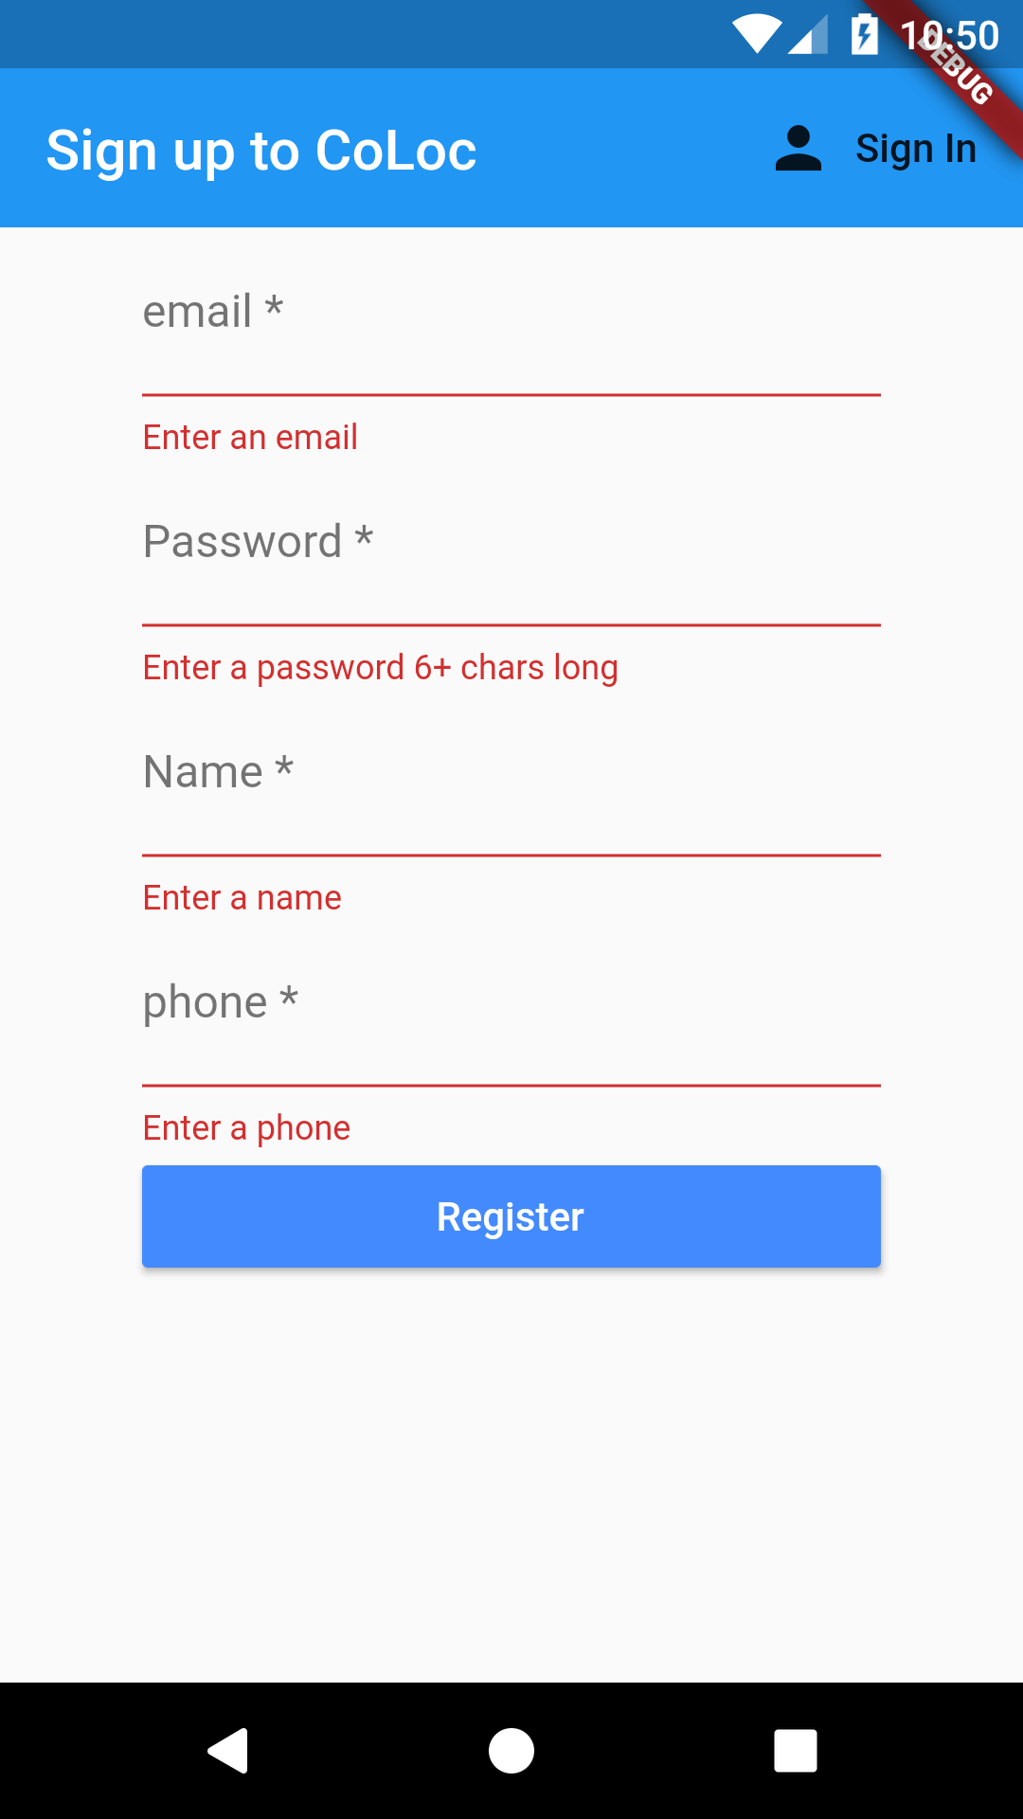
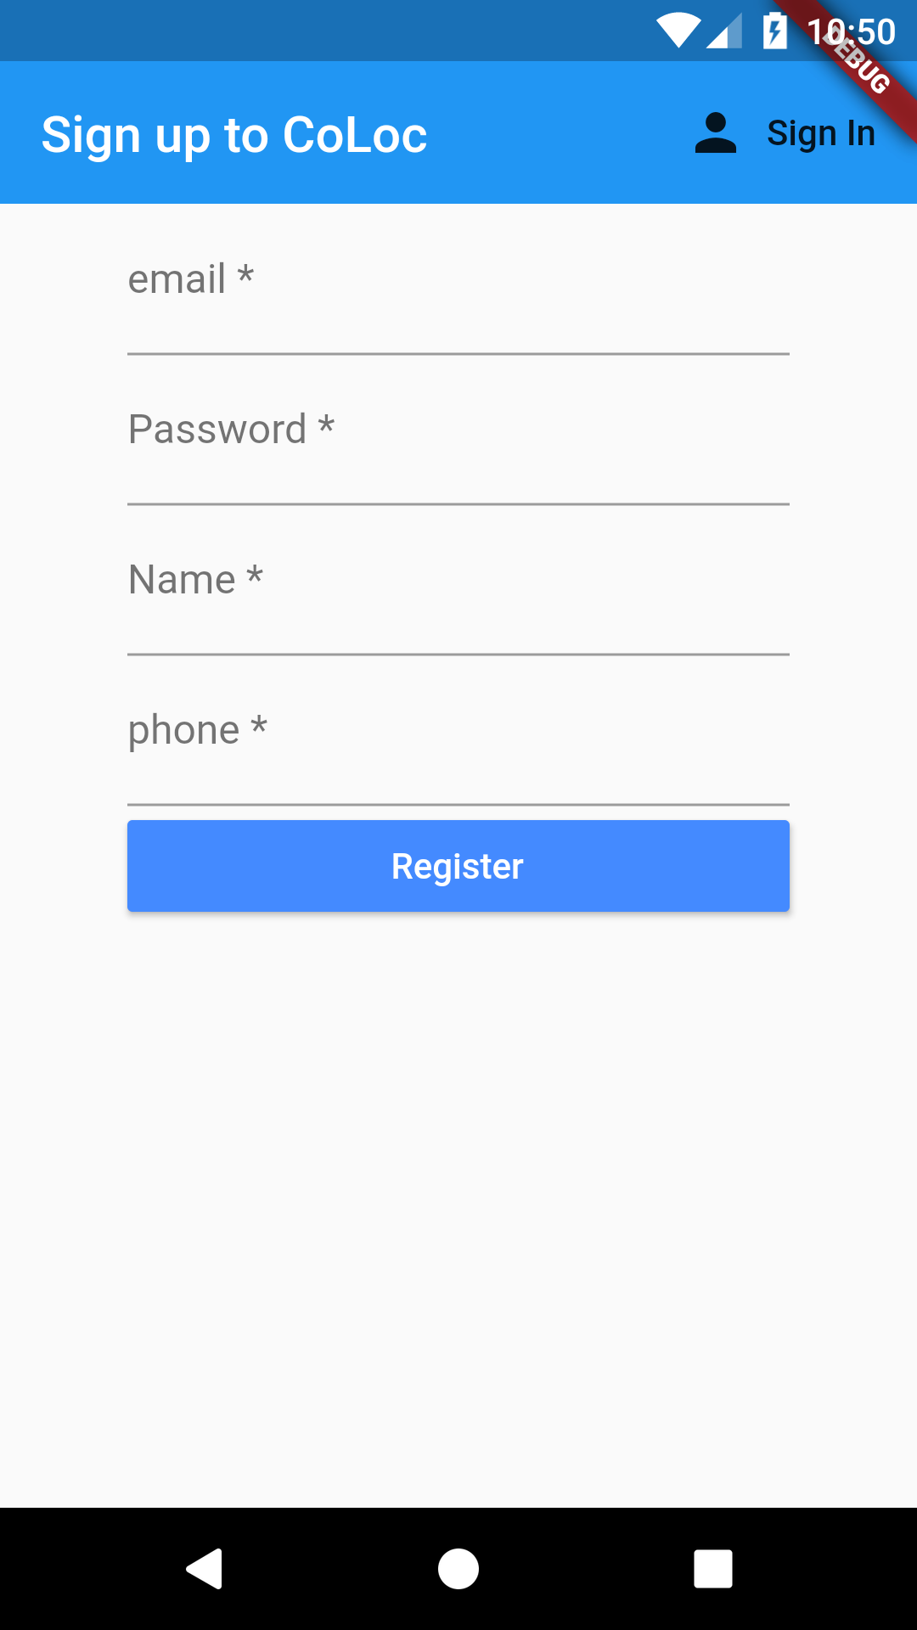
3- User Interfaces:
Registration Interface

Slide 6
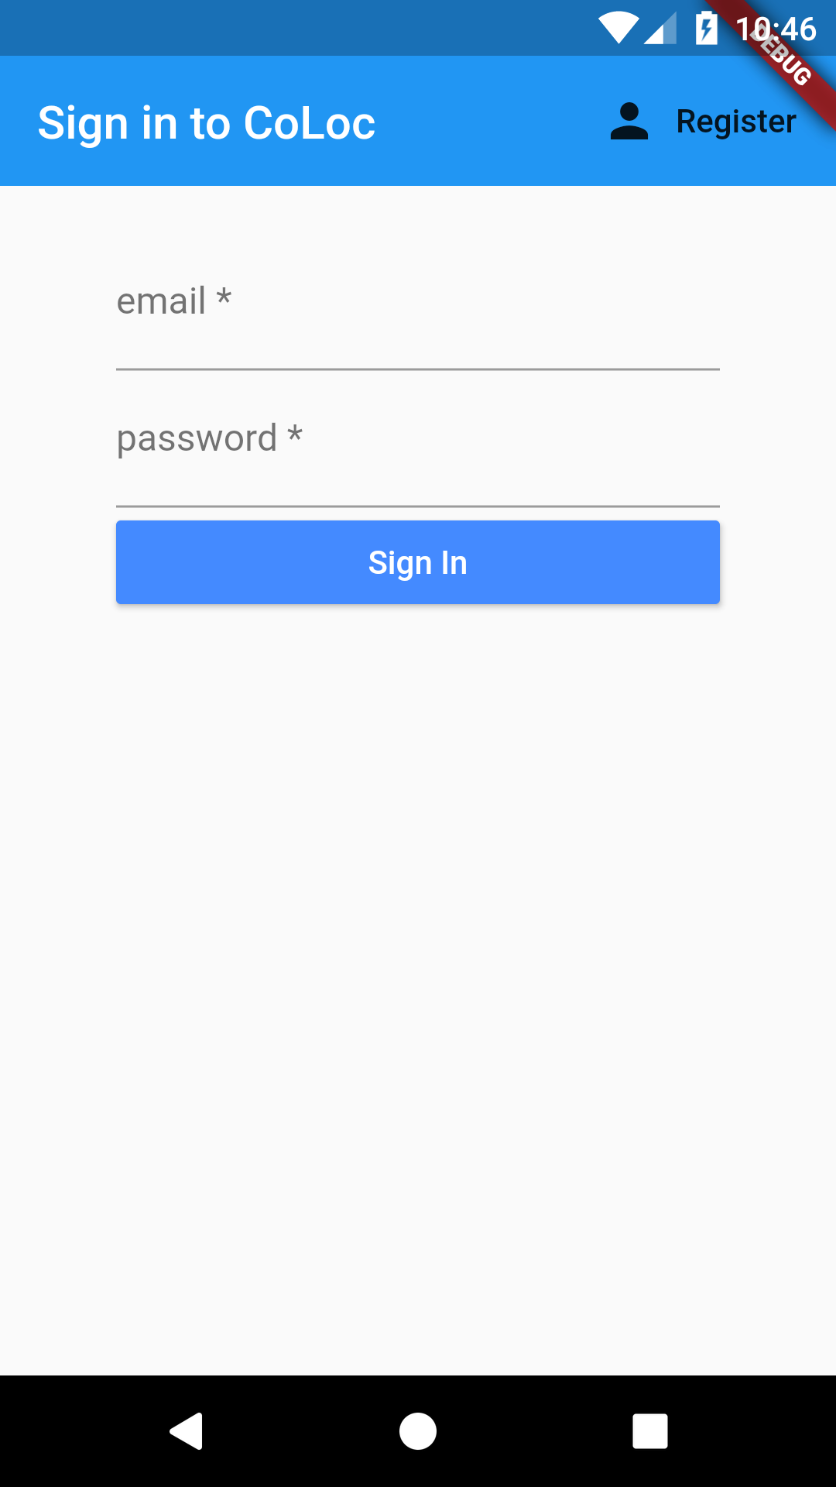
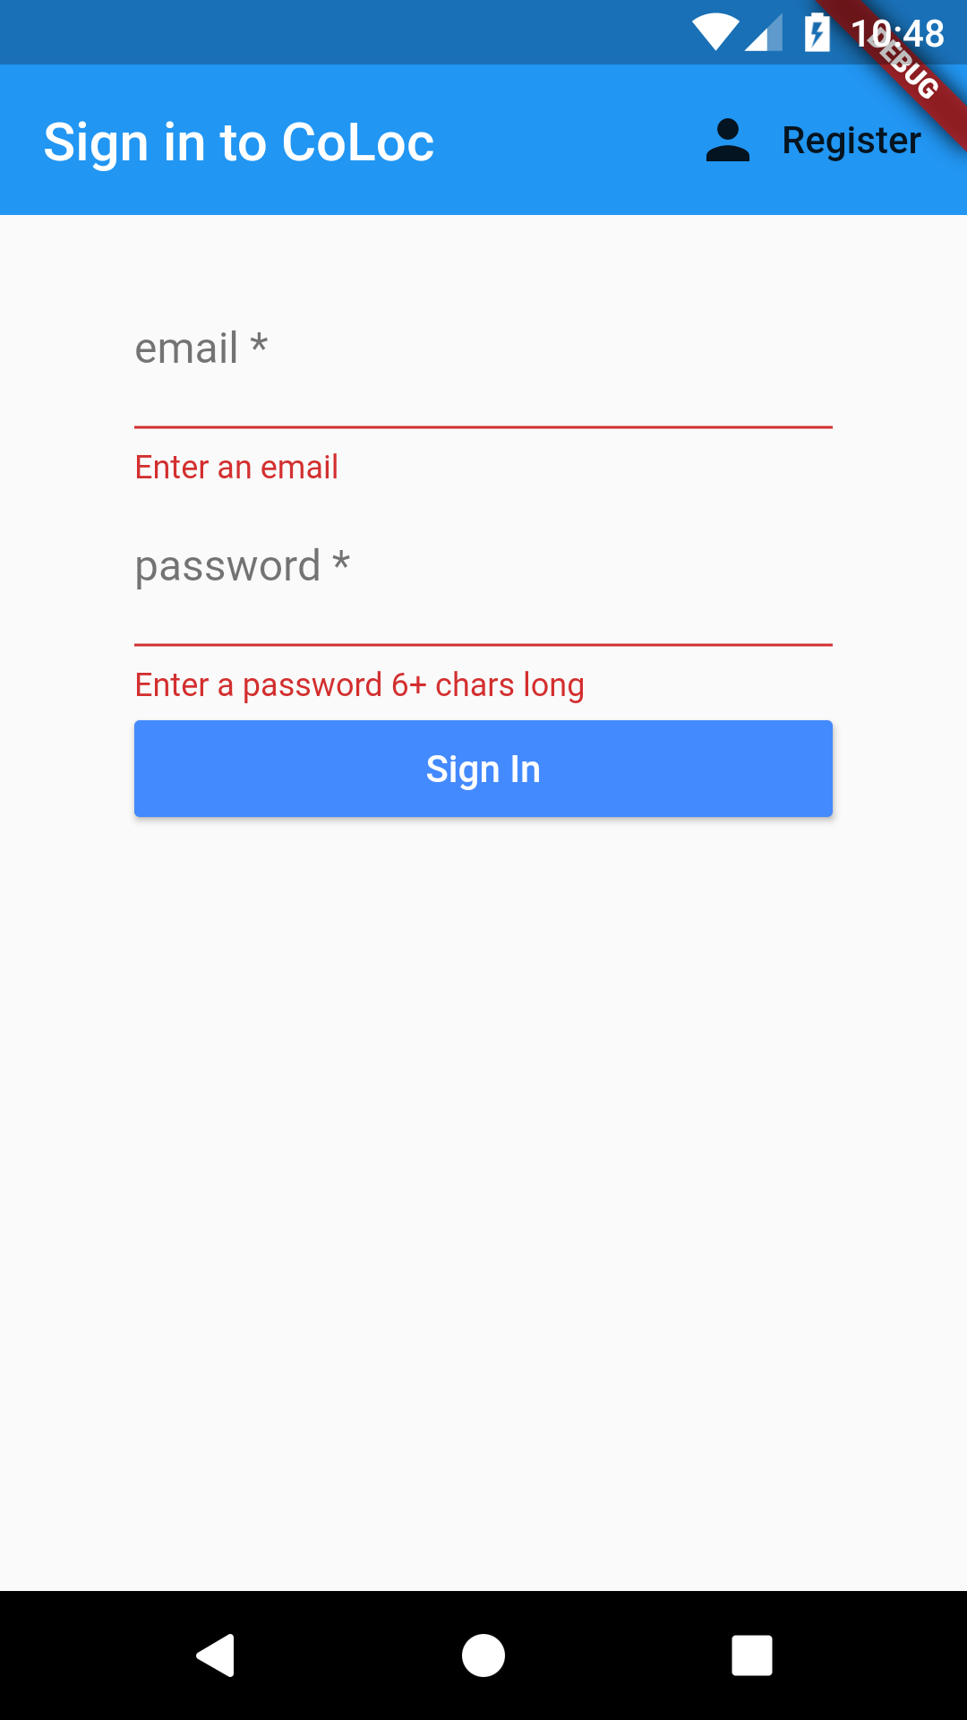
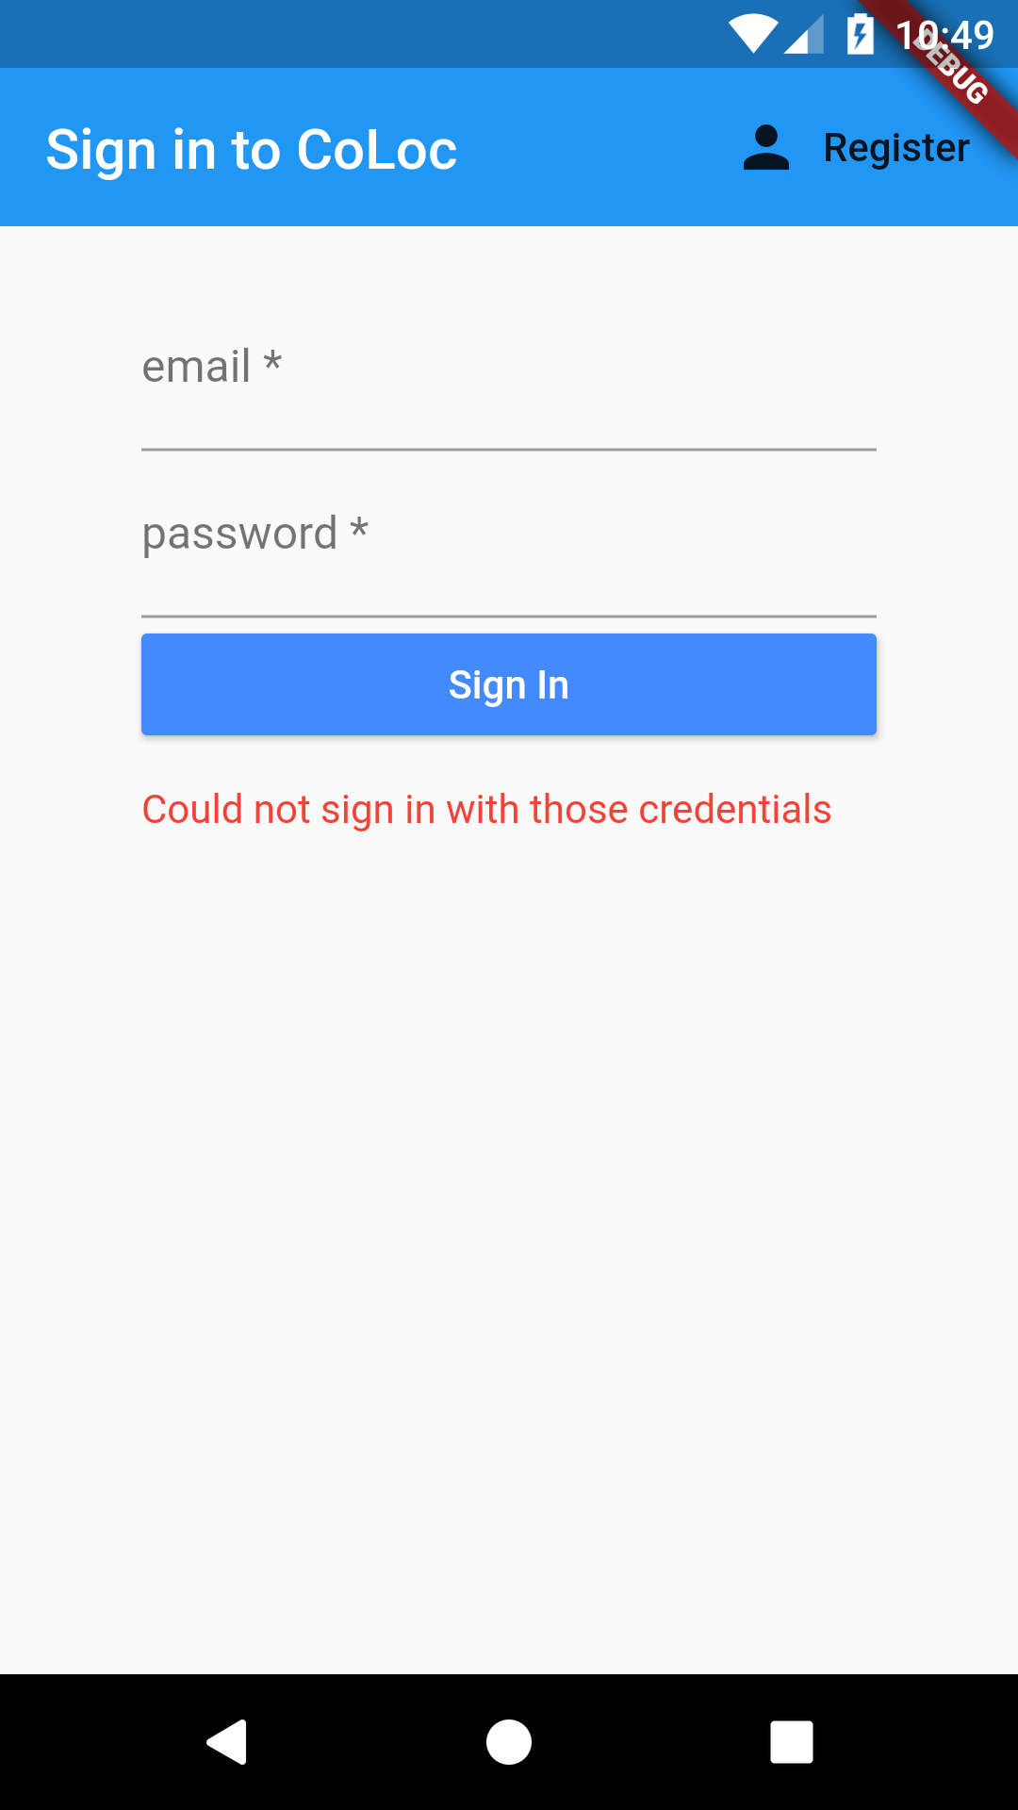
3- User Interfaces:
Sign-In Interface

Slide 7
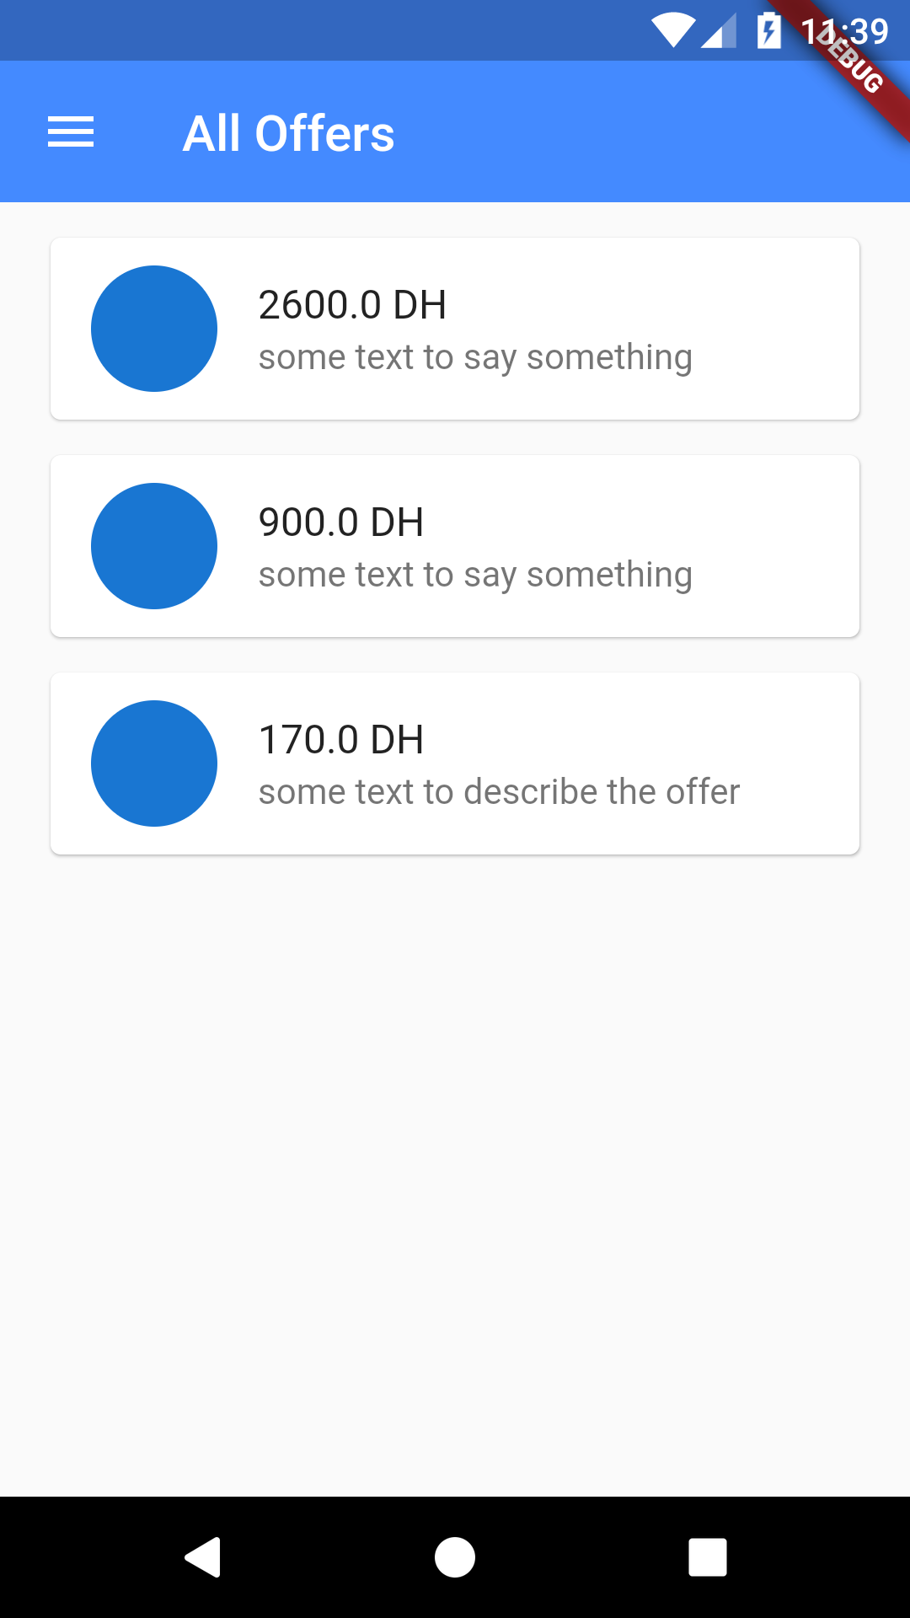
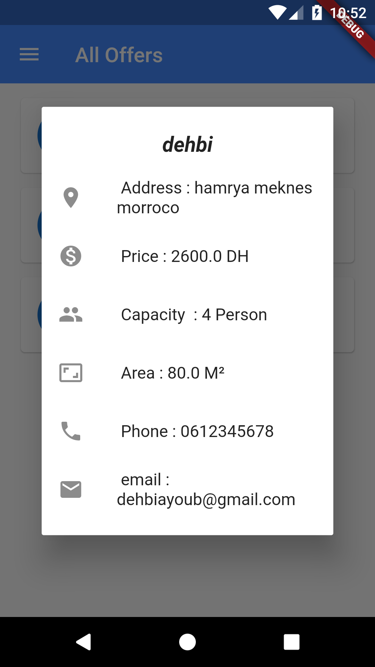
3- User Interfaces:
Offers Interface

Slide 8
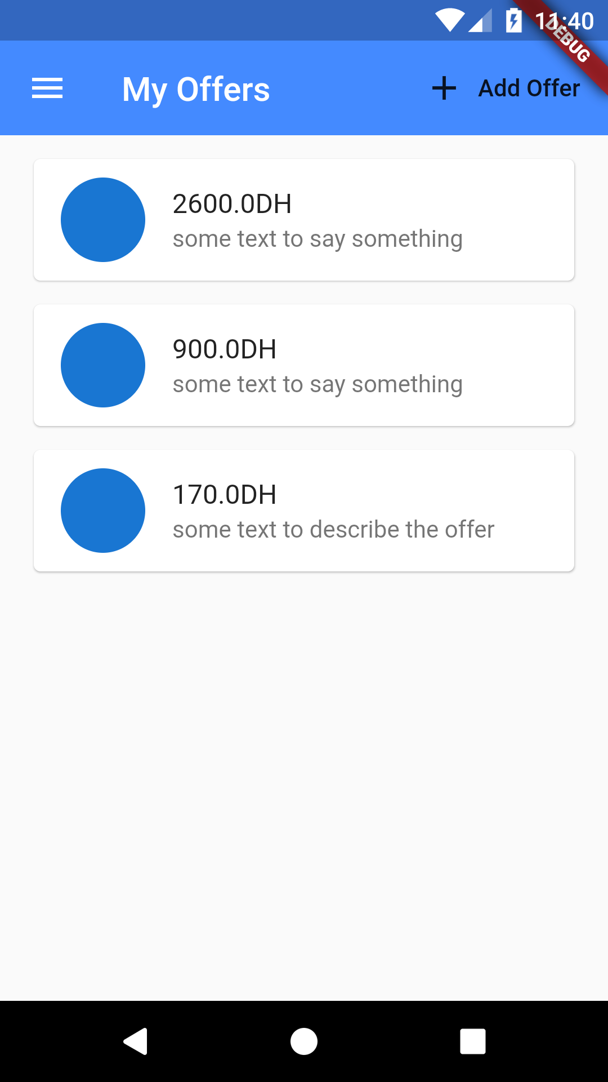
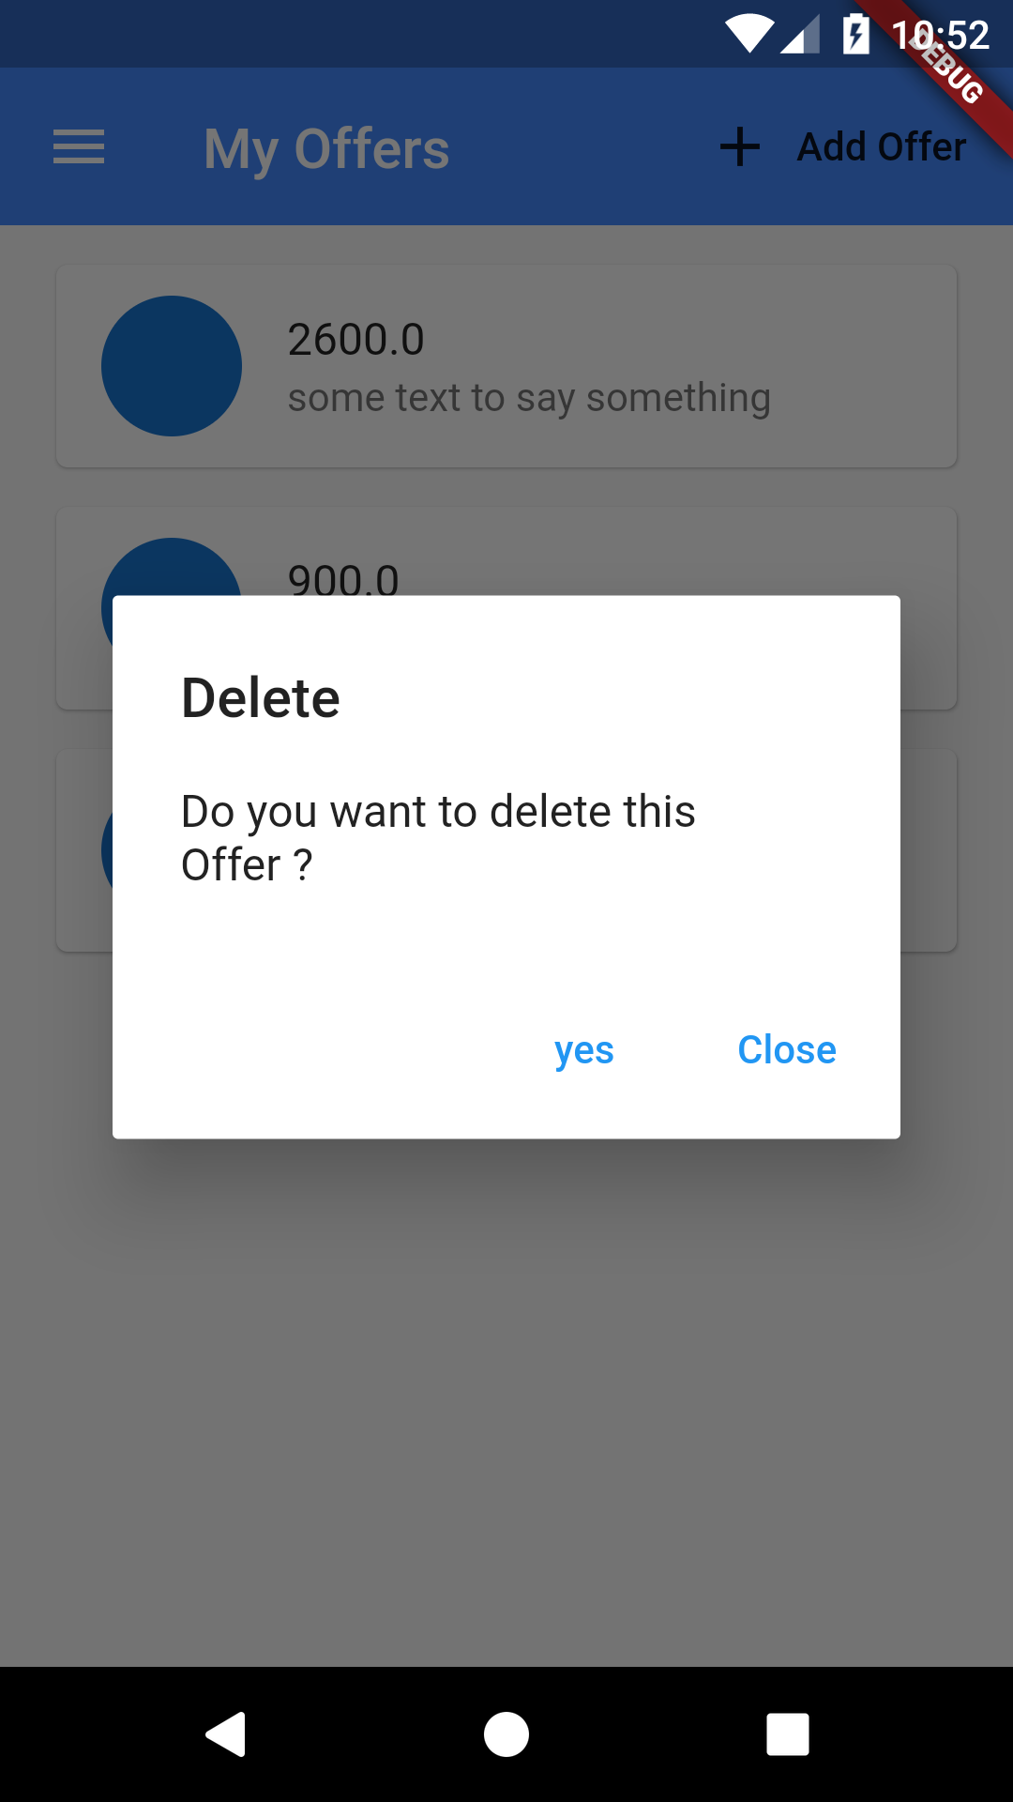
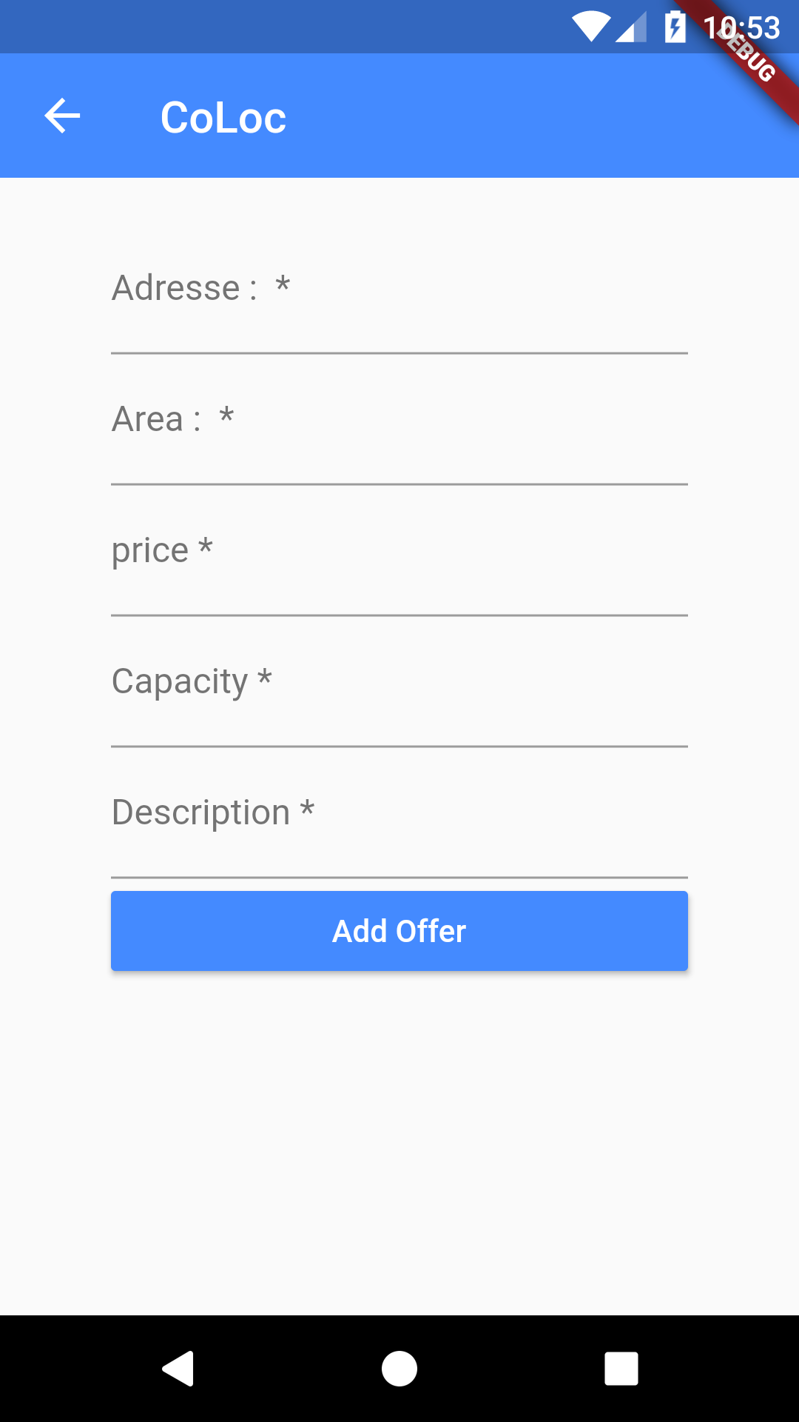
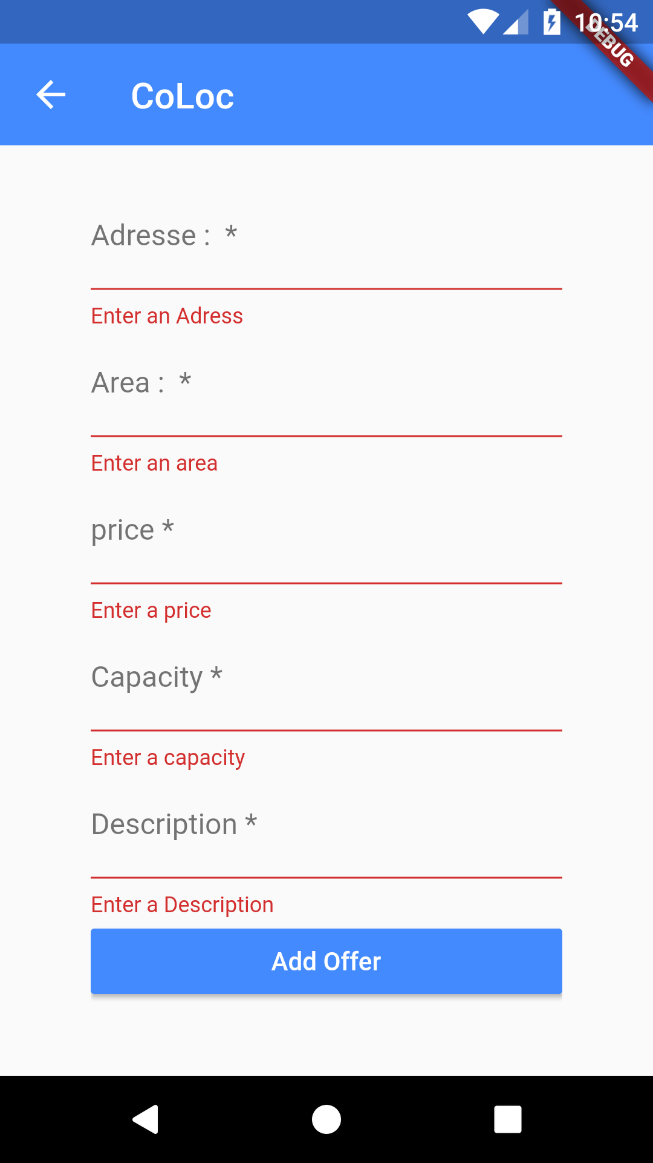
3- User Interfaces:
The User offers Interface

Slide 9
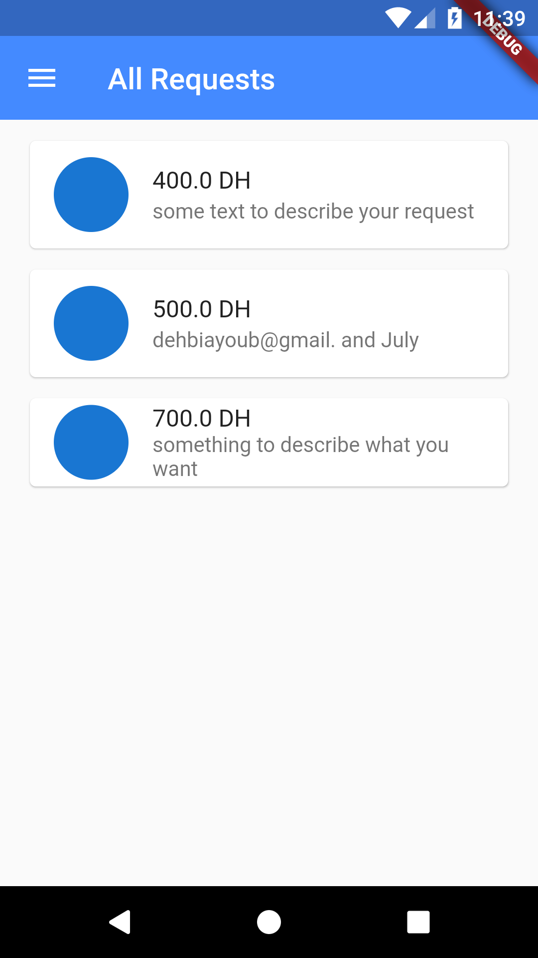
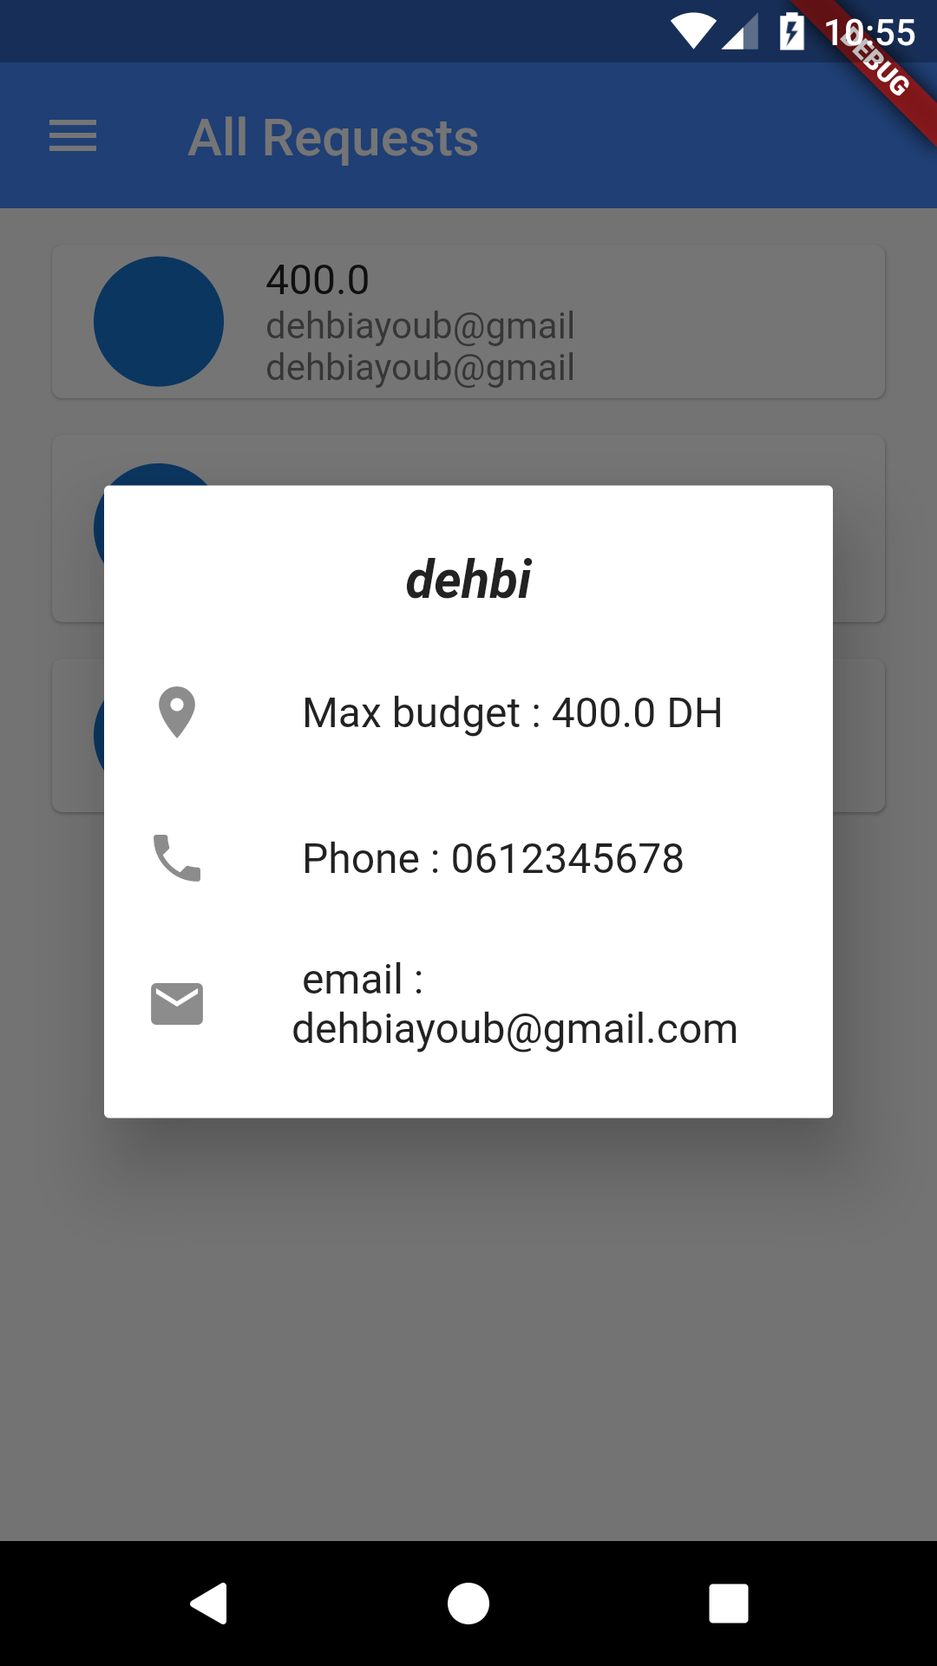
3- User Interfaces:
Requests Interface

Slide 10
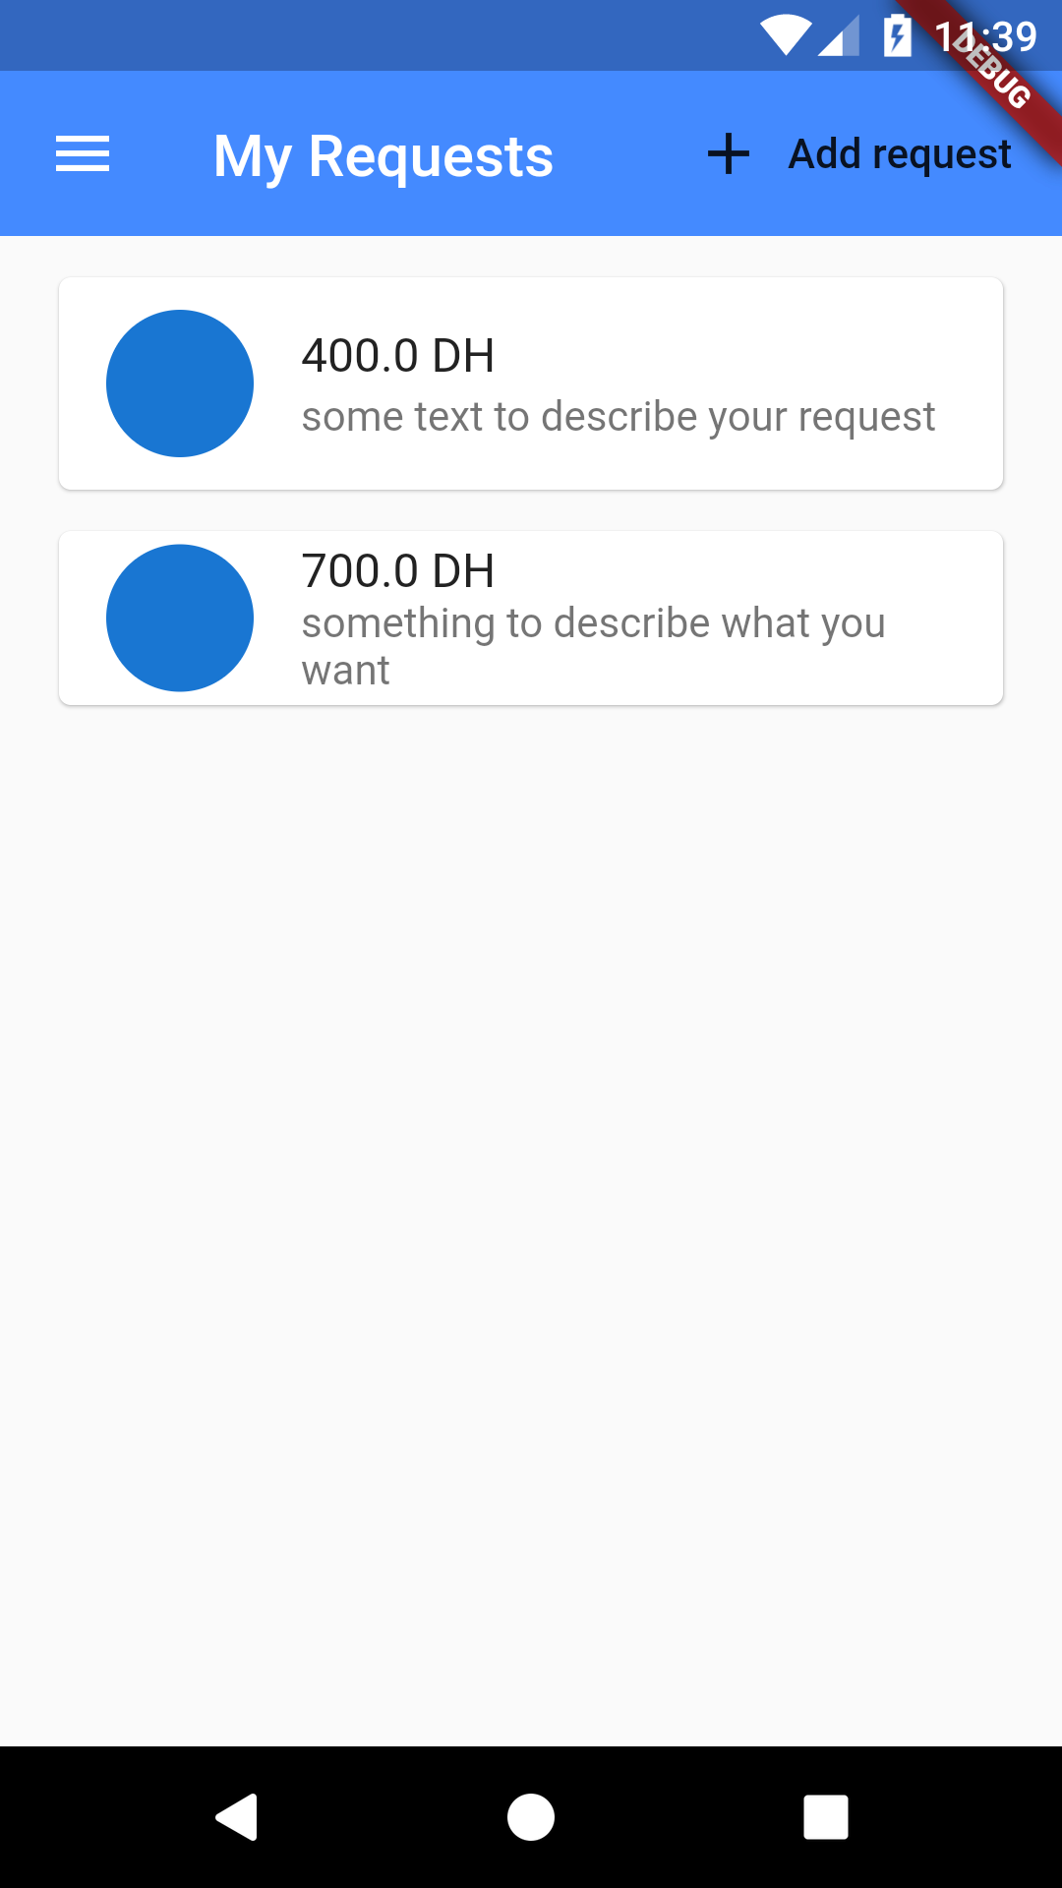
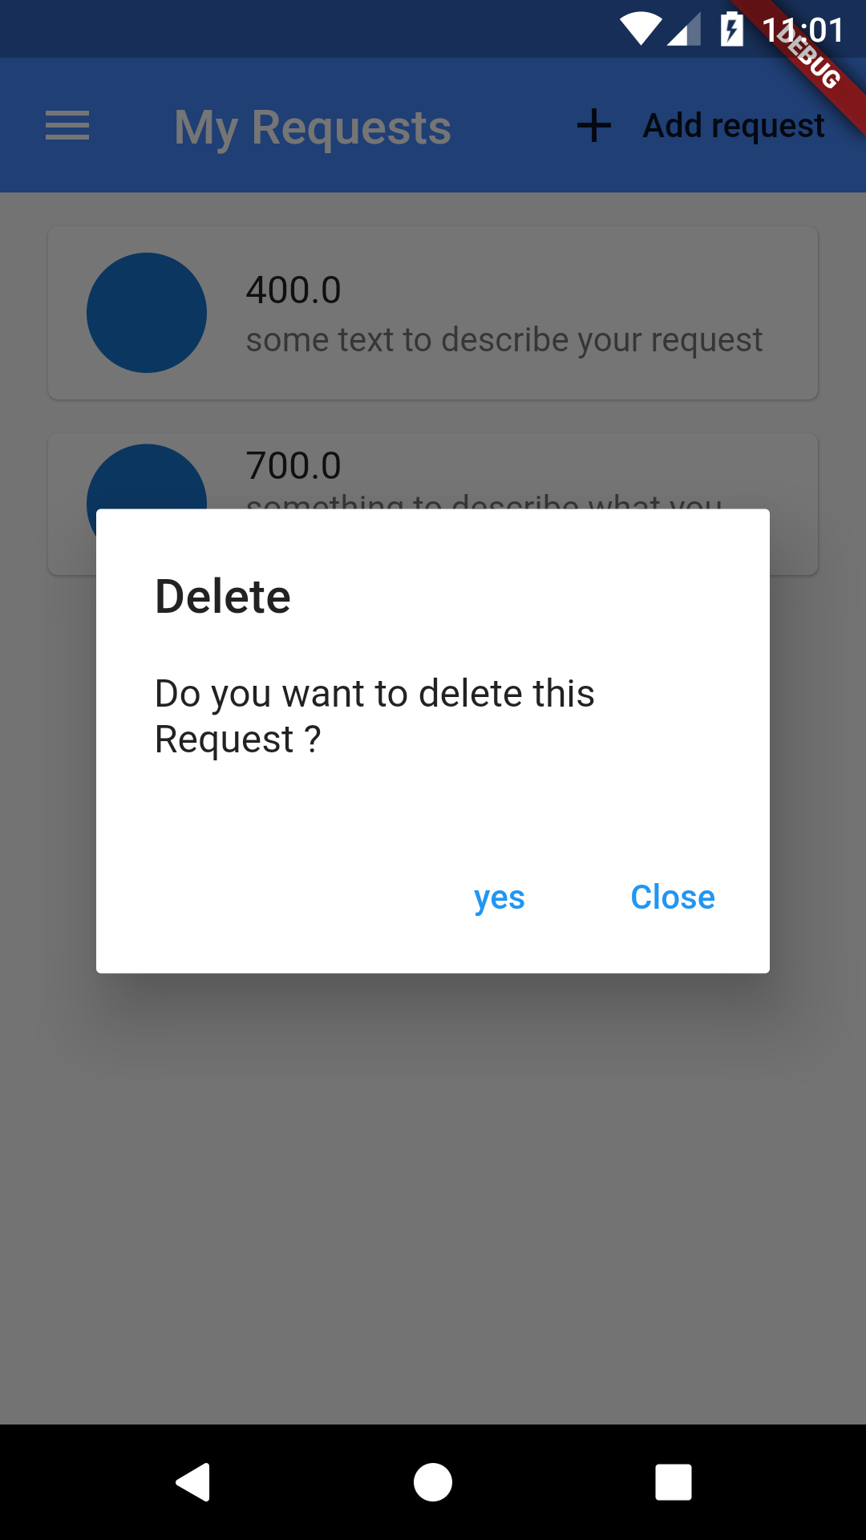
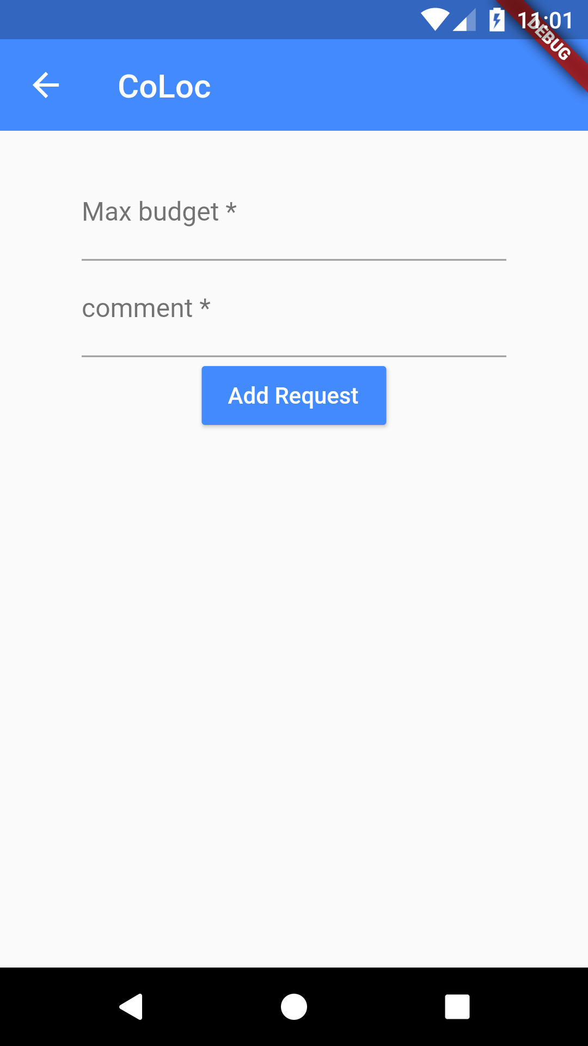
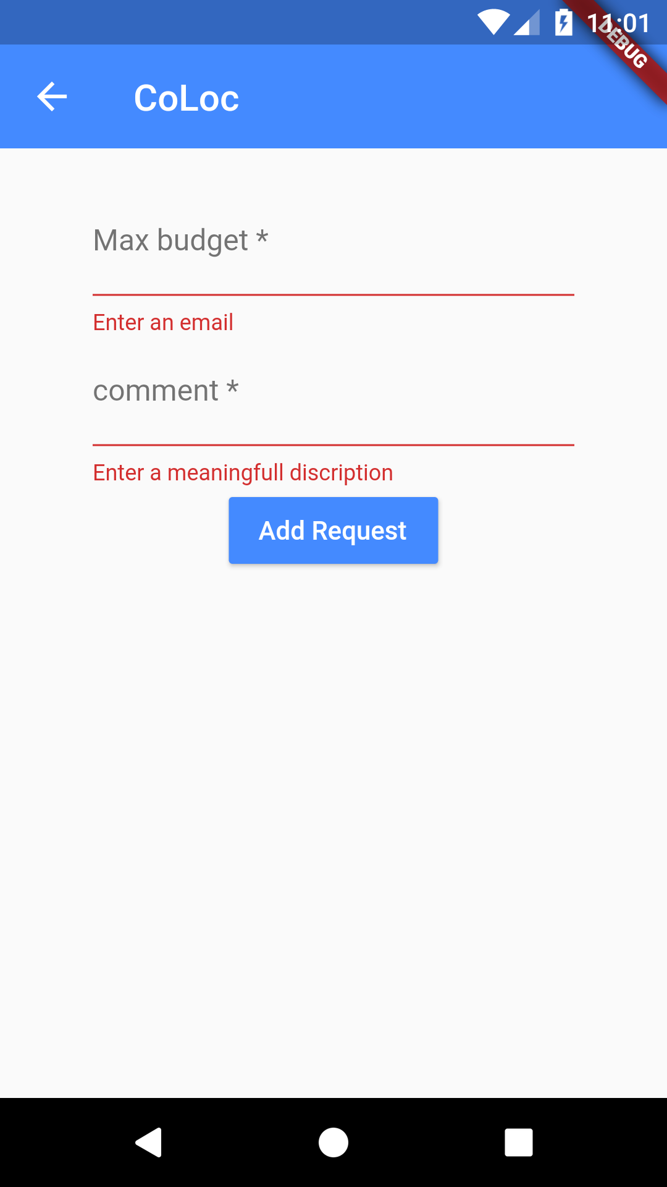
3- User Interfaces:
User Requests Interface

Slide 11
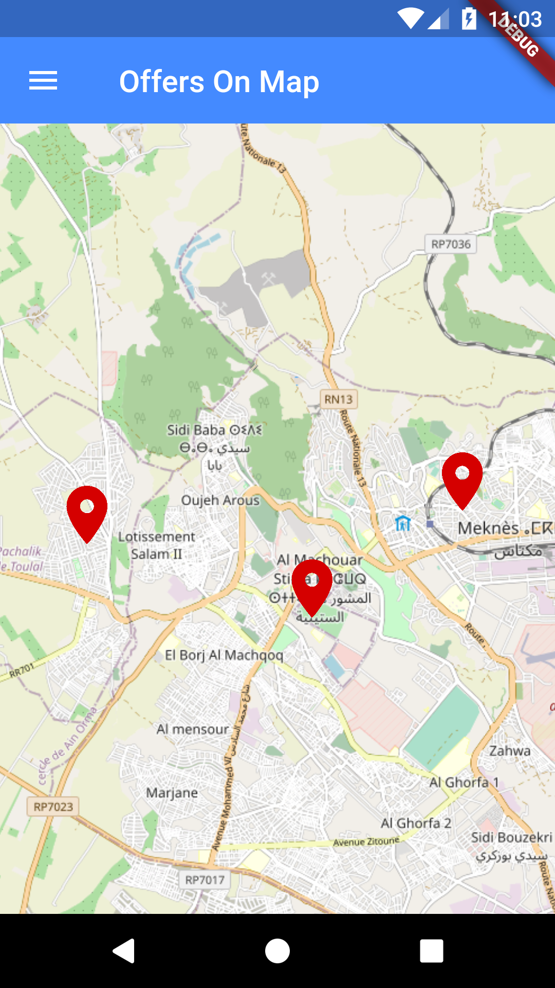
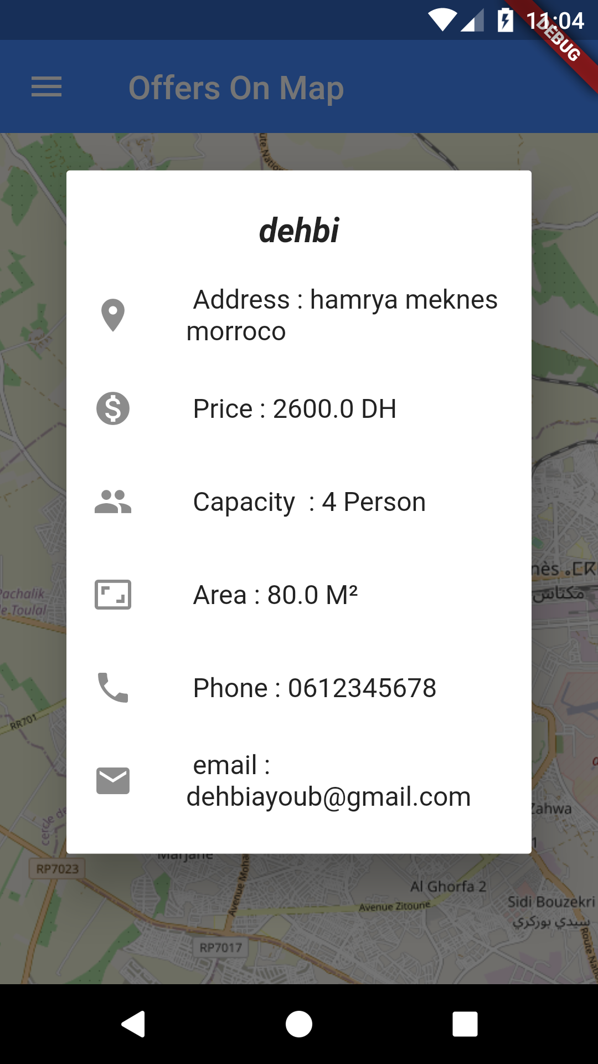
3- User Interfaces:
Map Offers Interface

Slide 12
References:
https://www.youtube.com/watch?v=_SHssHJJhAI&t=347s
https://medium.com/firebase-tips-tricks/how-to-use-cloud-firestore-in-flutter-9ea80593ca40
https://pub.dev/packages/flutter_map
https://pub.dev/packages/geocoder
https://pub.dev/packages/firebase_auth
https://pub.dev/packages/cloud_firestore
https://pub.dev/packages/provider
https://stackoverflow.com/questions/59428139/get-firebase-data-without-streambuilder
https://api.flutter.dev/flutter/widgets/ListView-class.html
GitHub : https://github.com/KitayDehbi/Co-location-Flutter-App

